Slide 1

Password generator

Slide 2
Password generator:
A password generator is a Software tool that creates random or customized passwords for users.Generate temporary password is now a requirement on almost every website now-a-days. In case a user forgets the password, system generates a random password adhering to password policy of the company.

Slide 3
*It should contain at least one capital case letter.
*It should contain at least one lower-case letter.
*It should contain at least one number.
*Length should be 8 characters.
*It should contain one of the following special characters: @, $, #, !.
Rules for generating password

Slide 4
Tips for generating password:
Follow these five tips for creating a secure password:Never use personal information.Include a combination of letters, numbers, and characters.Prioritize password length.Never repeat passwords.Avoid using real words.

Slide 5
PROPOSED SYSTEM :
This a software program that automatically generates a password using parameters that a user sets.
This program is built by GUI java with the help of jFrame.
Firstly,the necessary modules are imported.Then followed by creating necessary class for jFrame and to generate password.

Slide 6
PROGRAM :
package Miniproject;
import java.util.Random;
import java.awt.EventQueue;
import javax.swing.JFrame;
import javax.swing.JPanel;
import javax.swing.border.EmptyBorder;
import javax.swing.JLabel;
import java.awt.Font;
import java.awt.AWTEvent;
import java.awt.Color;
import javax.swing.JTextField;
import javax.swing.AbstractButton;
import javax.swing.JButton;
import javax.swing.JCheckBox;
import java.awt.event.ActionListener;
import java.awt.event.ActionEvent;

Slide 7
public class labeldemo extends JFrame {
/**
*
*/
private static final long serialVersionUID = 1L;
private JPanel contentPane;
private JTextField textField;
/**
* Launch the application.
*/
public static void main(String[] args) {
EventQueue.invokeLater(new Runnable() {
public void run() {
try {
labeldemo frame = new labeldemo();
frame.setVisible(true);
} catch (Exception e) {
e.printStackTrace();
}
}
});
}
/**
* Create the frame.
*/

Slide 8
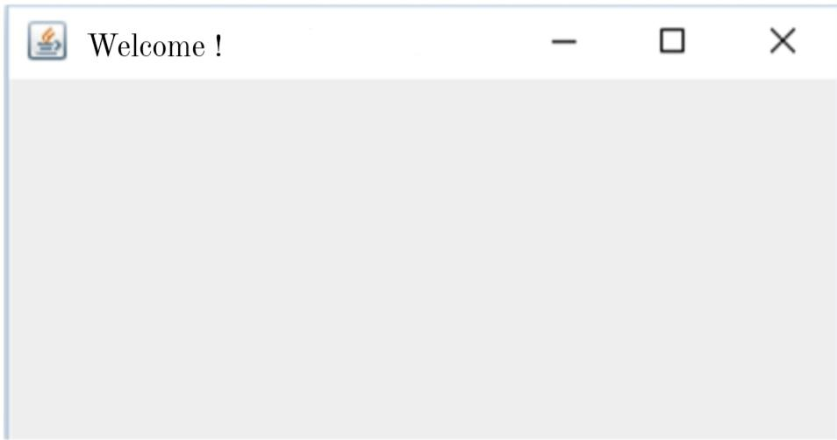
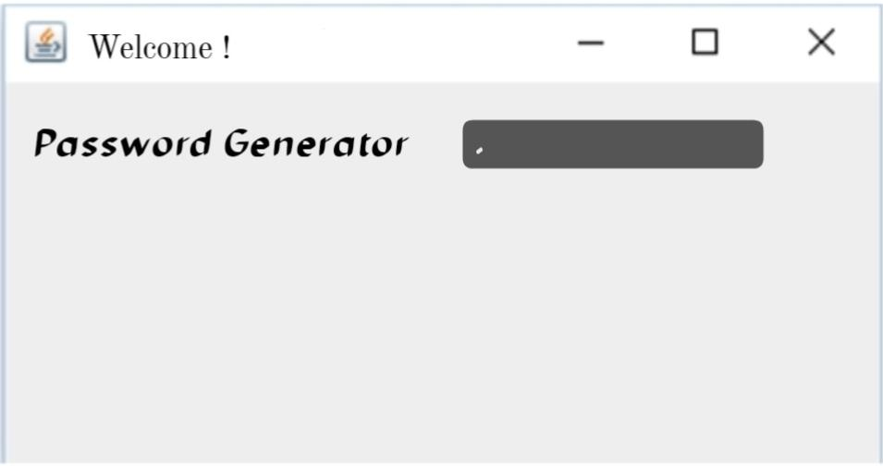
public labeldemo() {
setBackground(new Color(255, 255, 255));
setForeground(new Color(128, 128, 128));
setFont(new Font("Bodoni MT Black", Font.ITALIC, 20));
setTitle("WELCOME!");
setDefaultCloseOperation(JFrame.EXIT_ON_CLOSE);
setBounds(100, 100, 450, 300);
contentPane = new JPanel();
contentPane.setForeground(new Color(128, 128, 128));
contentPane.setBackground(new Color(0, 255, 255));
contentPane.setBorder(new EmptyBorder(0, 0, 0, 0));
setContentPane(contentPane);
contentPane.setLayout(null);
JLabel lblNewLabel = new JLabel("Password generator");
lblNewLabel.setBackground(new Color(0, 255, 255));
lblNewLabel.setFont(new Font("Bodoni MT Black", Font.BOLD | Font.ITALIC, 15));
lblNewLabel.setBounds(24, 24, 179, 27);
contentPane.add(lblNewLabel);
textField = new JTextField();
textField.setBackground(new Color(192, 192, 192));
textField.setBounds(216, 24, 210, 27);
contentPane.add(textField);
textField.setColumns(10);

Slide 9
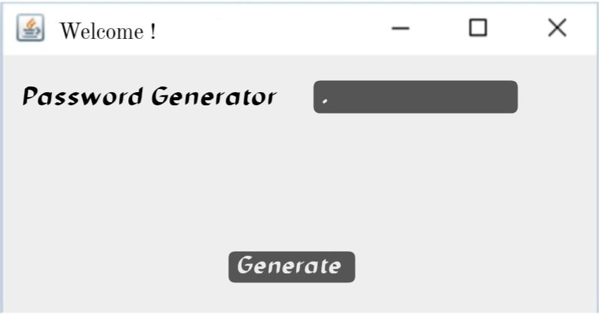
JButton btnNewButton = new JButton("Generate");
btnNewButton.addActionListener(new ActionListener() {
public void actionPerformed(ActionEvent e) {
int len=8;
String validChar="ABCDEFGHIJKLMNOPQRSTUVWXYZabcdefghijklmnopqrstuvwxyz1234567890!@#$";
StringBuilder st = new StringBuilder();
Random rand = new Random();
while(0<len--) {
st.append(validChar.charAt(rand.nextInt(validChar.length())));
}
textField.setText(st.toString());
}
});
btnNewButton.setForeground(new Color(128, 128, 128));
btnNewButton.setBackground(new Color(255, 255, 255));
btnNewButton.setFont(new Font("Roboto Cn", Font.BOLD | Font.ITALIC, 19));
btnNewButton.setBounds(154, 201, 146, 21);
contentPane.add(btnNewButton);

Slide 10
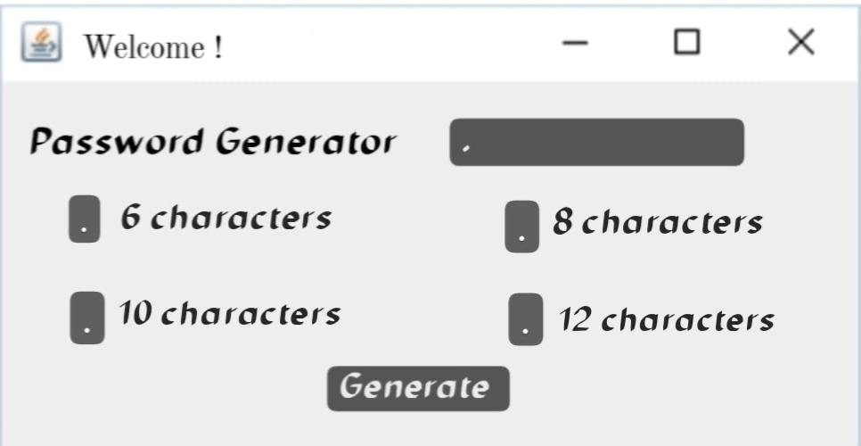
JCheckBox jCheckBox1 = new JCheckBox("6 Characters");
jCheckBox1.setBackground(new Color(128, 128, 128));
jCheckBox1.setFont(new Font("Californian FB", Font.BOLD, 17));
jCheckBox1.setBounds(39, 90, 125, 21);
contentPane.add(jCheckBox1);
JCheckBox jCheckBox2 = new JCheckBox("8 Characters");
jCheckBox2.setBackground(new Color(128, 128, 128));
jCheckBox2.setFont(new Font("Californian FB", Font.BOLD, 17));
jCheckBox2.setBounds(274, 90, 125, 21);
contentPane.add(jCheckBox2);
JCheckBox jCheckbox3 = new JCheckBox("10 Characters");
jCheckbox3.setBackground(new Color(128, 128, 128));
jCheckbox3.setFont(new Font("Californian FB", Font.BOLD, 17));
jCheckbox3.setBounds(39, 143, 125, 21);
contentPane.add(jCheckbox3);
JCheckBox jCheckbox4 = new JCheckBox("12 Characters");
jCheckbox4.setBackground(new Color(128, 128, 128));
jCheckbox4.setFont(new Font("Californian FB", Font.BOLD, 17));
jCheckbox4.setBounds(274, 143, 125, 21);
contentPane.add(jCheckbox4);
}
}

Slide 11
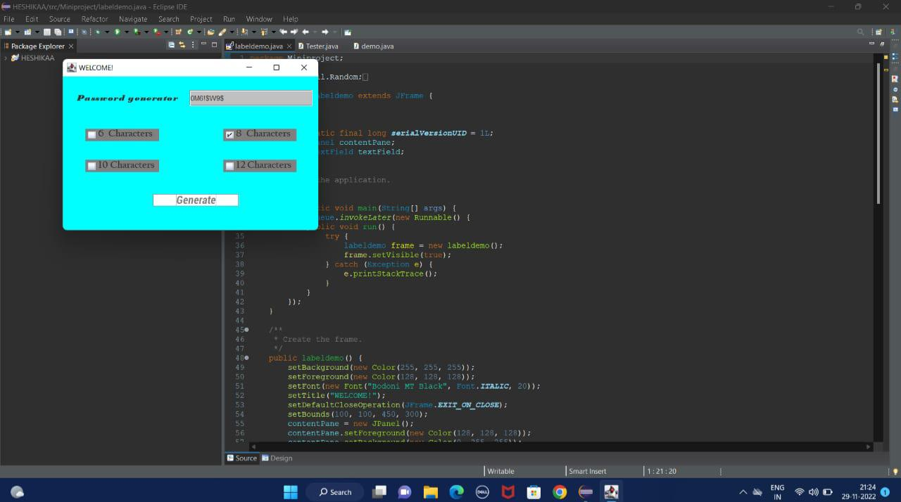
OUTPUT :

Slide 12
CONCLUSION :
The password generated using alpha-numerical randam password mechanisum that was illustrated above is practical and can be used with great results. Humans used to set password with their personal information such as names, birthday date or year such kind gives the space for the intrudes to deploy various attacks in breaking the passwords.The above done work creates awareness and interest to start exploring this field more.

Slide 13
Done by;
ARCHANA.D
ASSMIYA.J
HESHIKAA.S
MANIKANDAN.K

Slide 14
Thank you

